Slide 1
My Etharis backup
Lupus

Slide 2
—Balhoust in ’The little dragon’, By Terminus Ignominia Amodeus
“The world as we see it is a play, an act, a ruse. Everyone is in on it. And those who seem mad, are simply acting out a different one.”

Slide 3
Introduction
The stats
The person
The history
The fool

Slide 4
Overview
Birth
Age 7
Age 12
Age 17
Age 20
Current
Born sickly
Lonely kid
Toymaker
Puppeteer
Tragedy
The Fool

Slide 5
Childhood
Only child
Well off family
Born sick and very weak
Read a lot of books
Lonely and isolated
Yearned to meet people

Slide 6
Adolescence
Disliked because of his sickly strange appearance
A deep desire to connect with people
Decided he wanted to make people happy
Started making toys for kids
Left toys underneath his window
Seeing kids smile playing with them made him happy.
Still wanted a more personal connection

Slide 7
The young puppeteer
Puppeted toys he made
Created puppet plays
Hid behind a stage
Made joke-y comedies
For the first time he got acknowledged
Kids liked it

Slide 8
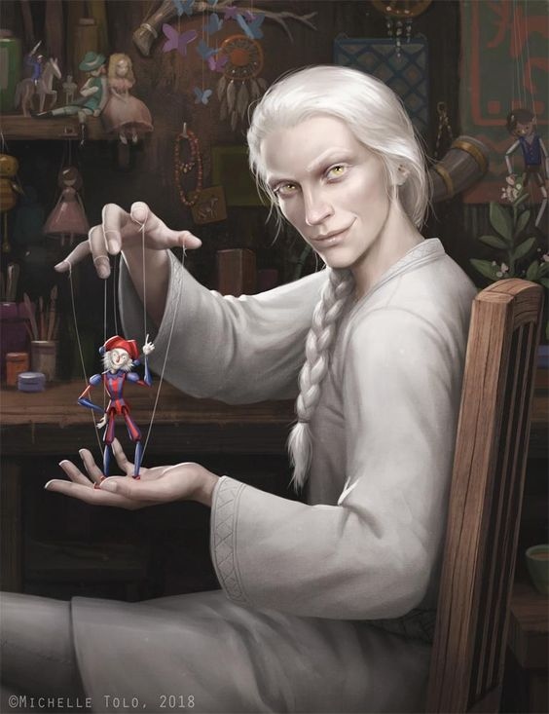
The Puppeteer
Matured with age
Imitated voices and animals
More story and drama in the comedy
Created “The fool”.
A magic man who brought wonder
Learned a few secret magic tricks on his own to enhance the performance.

Slide 9


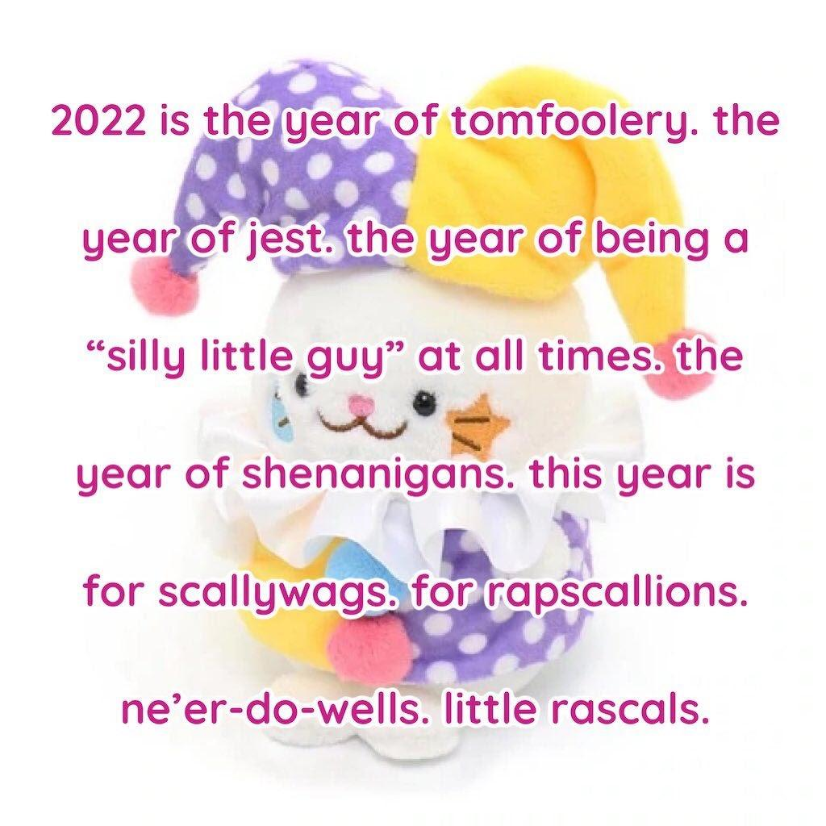
Small break
Everyone talk about backup ideas they’ve had

Slide 10
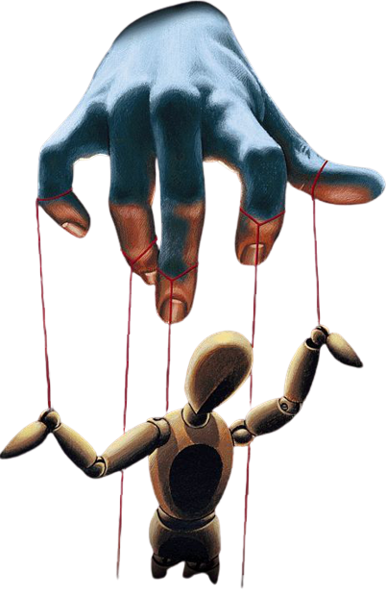
The puppet of ill fortune
His parents died suddenly
The rest of the family refused to take him in
He was left on the streets
He was still as sickly
He struggled to survive
His fevers worsened, leaving him to their whims
Started act parts in his stories in a delirium.

Slide 11
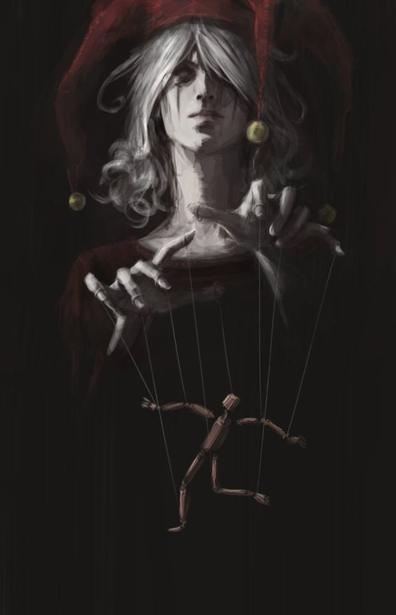
The fools folley
Remembers little from this time
A feverish delirium
Had to do dark things to survive
Was taken by varying states of madness and incomprehensibility at times
Started gaining a semi morbid attraction as a street performer.

Slide 12
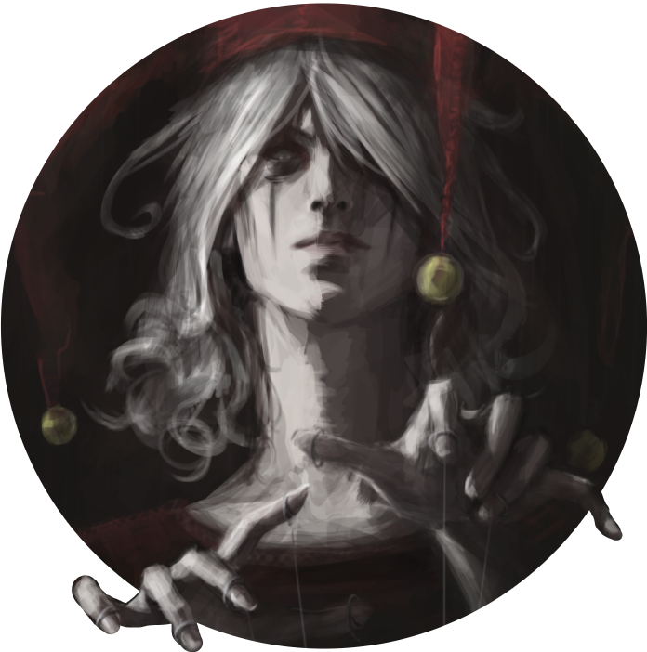
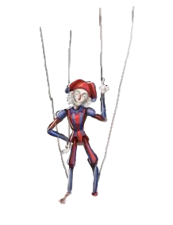
The Fool
Took the persona of the fool when performing
Ravaged by duality
Found a following in performance
Time on the streets had left their mark
Full of life, yet on the brink of death
He can do horrible things, yet also great kindness in the same breath
Life is like a lucid dream

Slide 13

The Dualities of a Fool
“There is truth in lies, there is wisdom in madness. These are the twin serpents of fate which are one and the same.”
-Father Enoch ‘The fall of the sky’,
By Terminus Ignominia Amodeus
The one
The other
Wisdom
Hate
Creation
Joy
The known
Balance
Chaos
Madness
Love
Destruction
Despair
The unknown
Imbalance
Order

Slide 14
The build
V. Human
Actor
Entertainer
Rogue
Arcane trickster
A Fool and puppeteer.

Slide 15
Stats
Str
Int
15
16
Dex
Wis
16
13
Con
Cha
6
18
Due to the weak health he’s tried to exercise and keep up his strength.
Due to his lonely childhood he’s read a lot of books.
It requires a lot of dexterity to puppet.
He’s learnt a bit from the ups and downs of his life
Sicily since childhood
His feverish nature often affects his decision making.
He’s trained himself since childhood to entertain.
Bumped by the actor feat

Slide 16
Thanks
Any questions?
Please keep this slide for attribution

